Slide 1
Lab Distributed Systems
Team 404
Bilal Moussa Fares
Mathijs Daemen
Jorre De Backer
Liam Hertoghs
Thomas Verschoor

Slide 2
Goal of the project
Creating a distributed application that uses our own middleware
Various components should have been implemented
Raspberry Pi’s

Slide 3
Team objects
Who? | Implementations
Bilal | Communications, REST, Naming, Replication & Agents
Jorre | Replication, UDP, Agents
Thomas | Communications, XML , REST, Naming, Replication and GUI
Mathijs | Hashing, Naming, Discovery, Replication, Agents, Cleaning up the code
Liam | Multithreading, communications, REST, Naming, Discovery, Replication, Cleaning up the code, make everything works fine
Everyone: helping testing and debugging + working out the project

Slide 4
Naming server
Jorre

Slide 5
discovery
UDP Multicast “Start”
UDP Unicast “Exit”
Server UDP Unicast responses to change previous - and next node on client exit

Slide 6
replication
Mathijs

Slide 7
agents
BILAL

Slide 8
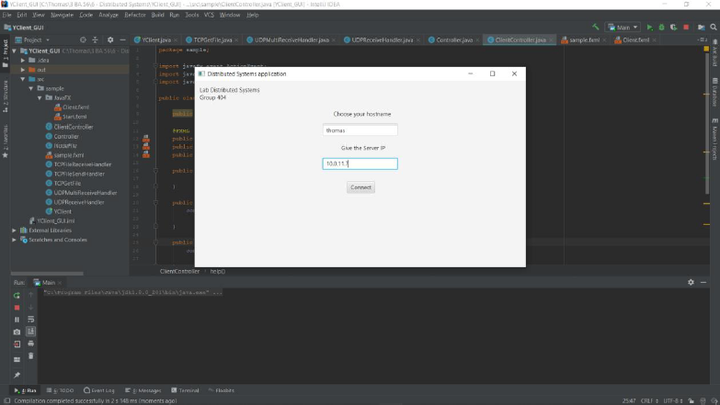
GUI
X11
Swing
JavaFX

Slide 9
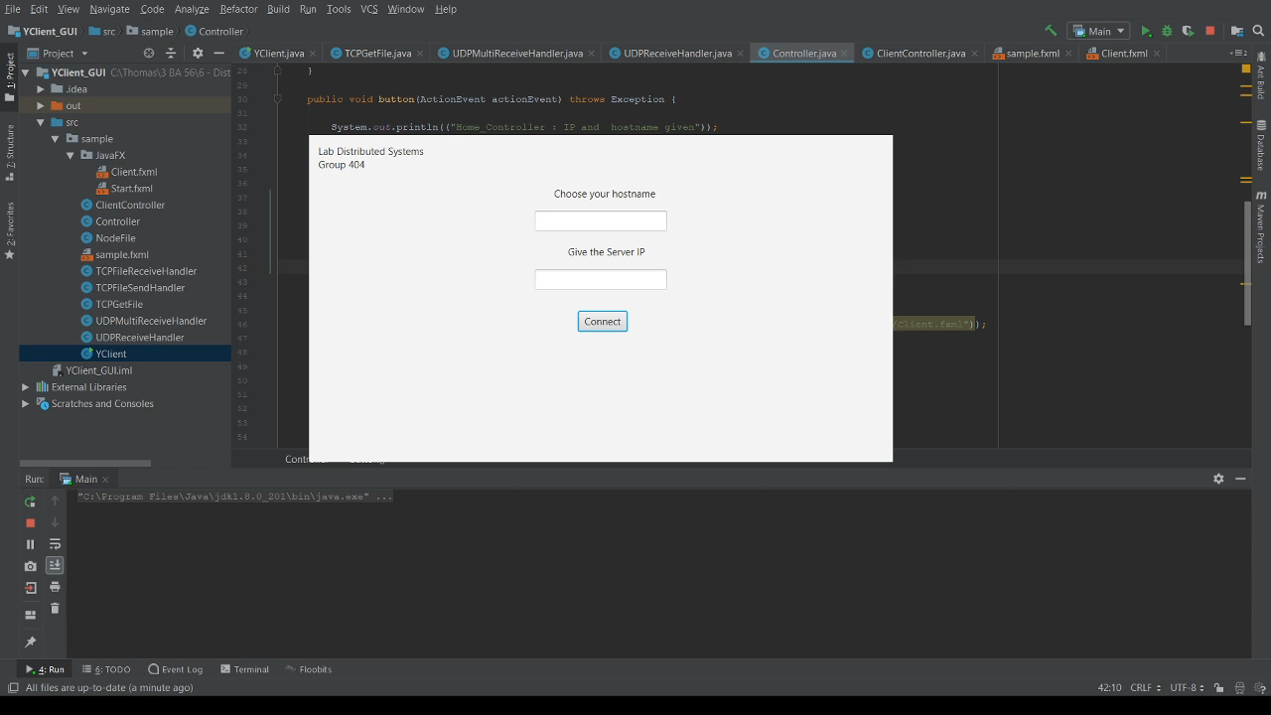
GUI

Slide 10
remarks
Sometimes we still get some exotic errors
Better writing of the code -> we got better view on whole project
Maybe improvement for next years?
Work more efficient: fool proofing > expanding
Wasted a lot of time on sub-projects

Slide 11
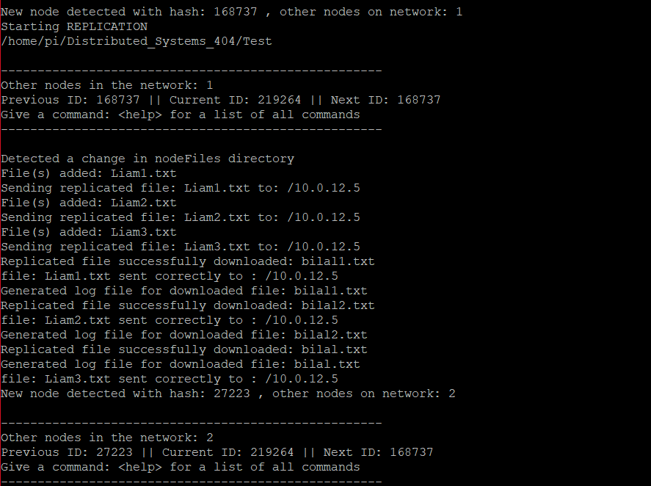
Final result
Live Demo

Slide 12
questions

